Slide 1






get doctors
Home
About
Doctors
Reviews
Contact
Login
GET
DOCTORS
get appoinment in any hospital as you want using our plateform. we can help to find your doctors
We Care Your Health
Find doctor
Prepared By :
Nofal Basan - 147
Arman Aghariya - 36
Sunasara Sajjad - 177

Slide 2


get doctors
Introduction
Welcome to our revolutionary project, where convenience meets healthcare excellence! Our platform serves as a seamless bridge between patients and doctors, empowering both parties with efficient tools for streamlined interactions and enhanced care experiences.
In this innovative portal, patients and doctors alike can register and login with ease, accessing a wealth of features tailored to their needs. For patients, the process is simple: just sign up, log in, and gain access to a world of healthcare at your fingertips. Meanwhile, doctors can effortlessly join the platform, establishing their presence and connecting with patients in a matter of moments.
Once logged in, patients can embark on their healthcare journey with confidence. Booking appointments has never been easier – a few clicks, and you're all set. Plus, we value patient feedback, providing a platform for reviews that ensure transparency and accountability within the healthcare ecosystem. Patients can share their experiences, enabling others to make informed decisions and fostering a culture of continuous improvement.

Slide 3




Get Doctors
Existing System
Patient and Doctors Registration
Appointment Booking
Appointment Management
Feedback and Reviews
Profile Management
Generate Report

Slide 4

Get Doctors
Need Of System
Enhanced Accessibility
Patients easily find suitable doctors; our platform centralizes searches based on preferences, including specialization and location.
Appointment Management
Patients book appointments online; doctors efficiently manage schedules, reducing overbooking and missed appointments.
Improved Patient-Doctor Communication
Seamless channels enable patients to convey concerns and feedback, fostering collaborative relationships and satisfaction.
Transparency
Patient reviews promote trust; doctors receive feedback for continuous improvement, enhancing healthcare transparency.

Slide 5

Get Doctors
Technology Stack
Frontend
HTML, CSS and BootStarp
JSP
Backend
Servlet, Java EE
Database
MySQL
Server
XAMPP
Tomcat

Slide 6

get doctors
Home
About
Doctors
Reviews
Contact
Login
SYSTEM
DESIGN
Prepared By :
Nofal Basan - 147
Arman Aghariya - 36
Sunasara Sajjad - 177

Slide 7
Get Doctors
DFD (Data Flow Diagram)
A data flow diagram is a graphical view of how data is processed in a system in terms of input and output. The Data flow diagram (DFD) contains some symbol for drawing the data flow diagram.
Context Level DFD :- Level-0
Get Doctors
Doctors
0.0
patient
Request
Request
Response
Response
Request
Response
Admin

Slide 8
Get Doctors
First Level DFD :– Level-1 (Main Admin )
1.0
main admin
1.1
Approve
Doctor
1.2
Disease Manage
1.3
Doctor Manage
1.4
Patient
Manage
1.5
Generate report
1.6
Analysis FeedBack
Req
Req
Req
Req
Req
Req
Res
Res
Res
Res
Res
Res
Doctors
Disease
Doctor
Patient
Doctor/Patient
Feedback

Slide 9
Get Doctors
First Level DFD :– Level-1 (Doctors)
2.0
Doctors
2.3
Appointment
Manage
2.1
Register/
Login
2.2
Skills Manage
2.4
Manage Profile
2.5
Patient Report
2.6
View FeedBack
Req
Req
Req
Req
Req
Req
Res
Res
Res
Res
Res
Res
Doctors
Skills
Appointment
Doctor
Patient
Feedback

Slide 10
Get Doctors
First Level DFD :– Level-1 (Patient)
3.0
Patient
3.1
Register/
Login
3.2
Book Appointment
3.3
Search
Doctors
3.4
Sort
Doctor
3.5
Manage Profile
3.6
Give FeedBack
Req
Req
Req
Req
Req
Req
Res
Res
Res
Res
Res
Res
Patient
Appointment
Doctor
Doctor
Patient
Feedback

Slide 11
Get Doctors
Second Level DFD :– Level-2 (Book Appointment)
3.2.1
Pay Fees
3.2
Book Appointment
Req
Payment
3.0
Patient
Res
Req
Res
Appointment

Slide 12
Get Doctors
Work Flow
Register Request
Doctors
Main Admin
Login
Add Skills
View Feedback
Add Disease
Feedback Analysis
Doctors
Skills
Disease
Patient
Appointment
Payment
Feedback
Register Login
Search Doctor
Select Doctor
Book Appointment
Pay Fees
Give Feedback
Patient

Slide 13

get doctors
Home
About
Doctors
Reviews
Contact
Login
Data
Dictionary
Our database name is “get_doctors” and this database has 8 tables.
1) appointment
2) disease
3) doctor
4) feedback
5) main_admin
6) patient
7) payment
8) skills

Slide 14
Get Doctors
1. Main_admin Table :-
Field Name | Data type /size | Constraint | Description
admin_id | INT(1O) | PRIMARY KEY | it’s a unique id of admin
username | VARCHAR(50) | NOT NULL | perform the login operation
email | VARCHAR(30) | NOT NULL | Store admin email
password | VARCHAR(30) | NOT NULL | perform the login operation
number | VARCHAR(30) | NOT NULL | Admin contact information

Slide 15
Get Doctors
2. Doctor Table :-
Field Name | Data type /size | Constraint | Description
doctor_id | INT(1O) | PRIMARY KEY | it’s a unique id of doctor
name | VARCHAR(50) | NOT NULL | Name of doctor
email | VARCHAR(30) | NOT NULL | Store doctor email
number | VARCHAR(20) | NOT NULL | Doctor contact information
address | VARCHAR(50) | NOT NULL | Doctor address
specialization | VARCHAR(50) | NOT NULL | Doctor specialization
experience | INT(10) | NOT NULL | Doctor experience
qualification | VARCHAR(50) | NOT NULL | Doctor qualification
Profile_picture | VARCHAR(200) | NOT NULL | Doctor image
status | VARCHAR(50) | NOT NULL | Doctor status
username | VARCHAR(50) | NOT NULL | perform the login operation
password | VARCHAR(50) | NOT NULL | perform the login operation

Slide 16
Get Doctors
3. Patient Table :-
Field Name | Data type /size | Constraint | Description
patient_id | INT(10) | PRIMARY KEY | it’s a unique id of patient
name | VARCHAR(50) | NOT NULL | Name of patient
email | VARCHAR(30) | NOT NULL | Store patient email
address | VARCHAR(50) | NOT NULL | Patient address
age | INT(10) | NOT NULL | Patient age
number | VARCHAR(20) | NOT NULL | Doctor contact information
password | VARCHAR(50) | NOT NULL | perform the login operation

Slide 17
Get Doctors
4. Appointment Table :-
Field Name | Data type /size | Constraint | Description
appointment_id | INT(10) | PRIMARY KEY | it’s a unique id of appointment
patient name | VARCHAR(50) | NOT NULL | Name of patient
patient email | VARCHAR(30) | NOT NULL | Store patient email
appointment _date | DATE() | NOT NULL | Appointment date
appointment_time | TIME() | NOT NULL | Appointment time
appointment_status | VARCHAR(50) | NOT NULL | Schedule of Appointment
additional_note | VARCHAR(50) | NOT NULL | Feedback
doctor_id | INT(1O) | FOREIGN KEY | it’s a unique id of doctor
patient_id | INT(10) | FOREIGN KEY | it’s a unique id of patient
disease | INT(10) | FOREIGN KEY | Disease id

Slide 18
Get Doctors
5. Feedback Table :-
Field Name | Data type /size | Constraint | Description
review_id | INT(10) | PRIMARY KEY | it’s a unique id
rating | INT(10) | NOT NULL | Doctor rating given by patient
review_text | VARCHAR(50) | NOT NULL | Review text given by patient
review_date_time | DATETIME() | NOT NULL | Review date/time
doctor_id | INT(1O) | FOREIGN KEY | it’s a unique id of doctor
patient_id | INT(10) | FOREIGN KEY | it’s a unique id of patient

Slide 19
Get Doctors
6. Skills Table :-
Field Name | Data type /size | Constraint | Description
skill_id | INT(10) | PRIMARY KEY | it’s a unique id
skill_name | VARCHAR(50) | NOT NULL | Name of skill
status | VARCHAR(50) | NOT NULL | Enable /disable skill
doctor_id | INT(1O) | FOREIGN KEY | it’s a unique id of doctor

Slide 20
Get Doctors
7. Disease Table :-
Field Name | Data type /size | Constraint | Description
disease _id | INT(10) | PRIMARY KEY | Disease id
disease_name | VARCHAR(50) | NOT NULL | Disease name
status | VARCHAR(50) | NOT NULL | Enable /disable skill

Slide 21
Get Doctors
8. Payment Table :-
Field Name | Data type /size | Constraint | Description
payment_id | INT(10) | PRIMARY KEY | it’s a unique id
payment_amount | INT(100) | NOT NULL | it’s a unique id
payment_date_time | DATETIME() | NOT NULL | Review date/time
payment_status | VARCHAR(50) | NOT NULL | Track payment status
doctor_id | INT(1O) | FOREIGN KEY | it’s a unique id of doctor
patient_id | INT(10) | FOREIGN KEY | it’s a unique id of patient

Slide 22

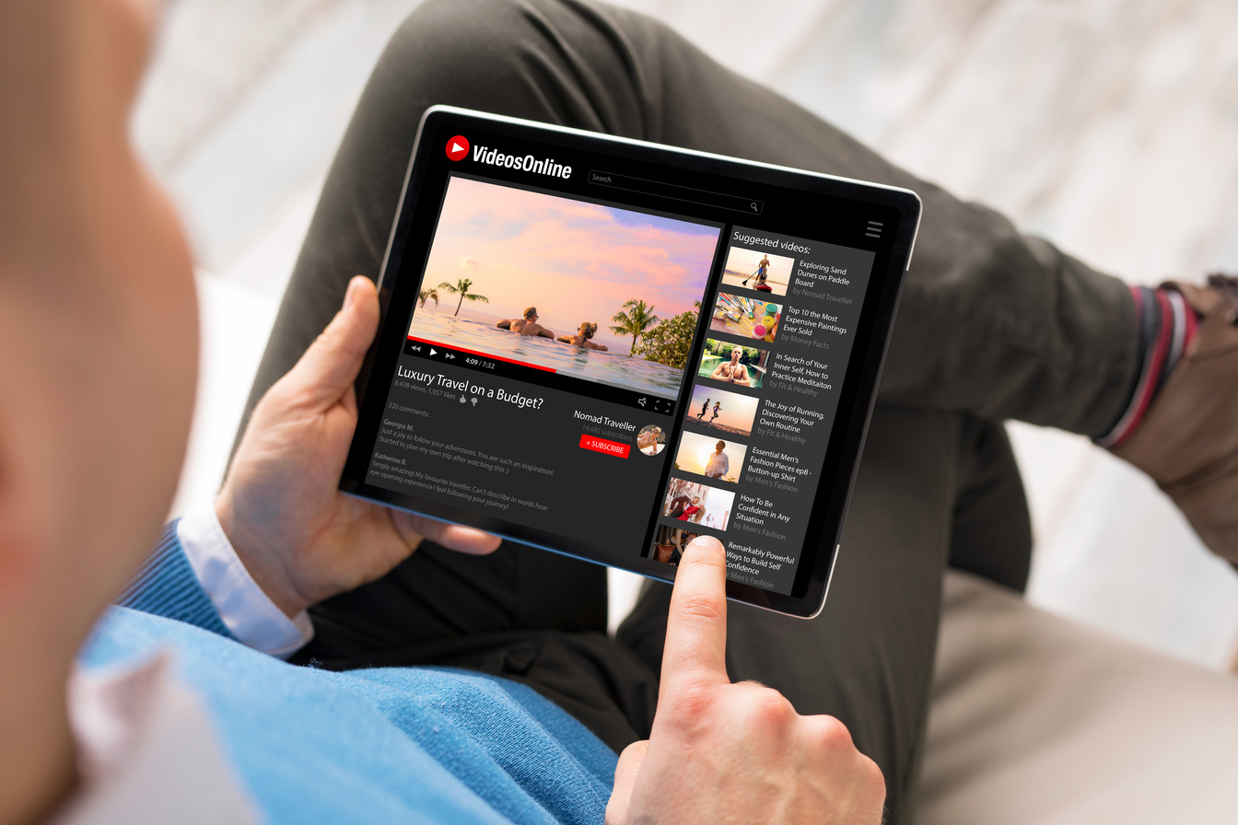

Get Doctors
Client Side Screenshot
Client & Admin
Screenshots
Admin Side Screenshot

Slide 23
Get Doctors
Client Side Screenshots

Slide 24
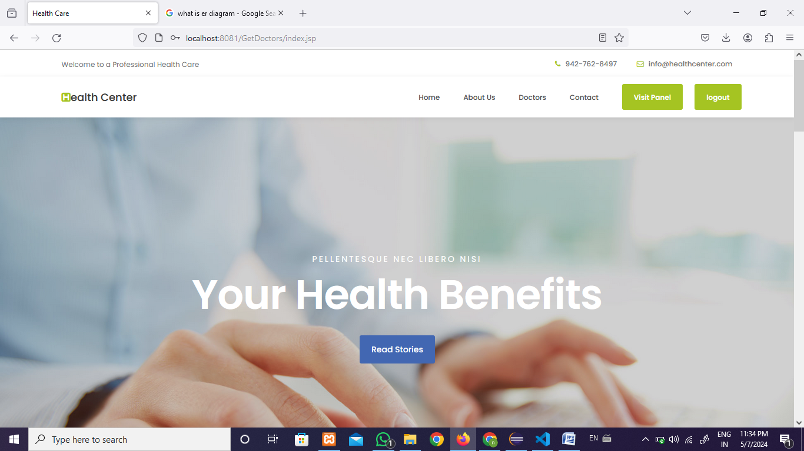
Get Doctors
Home Page 1 :-

Slide 25
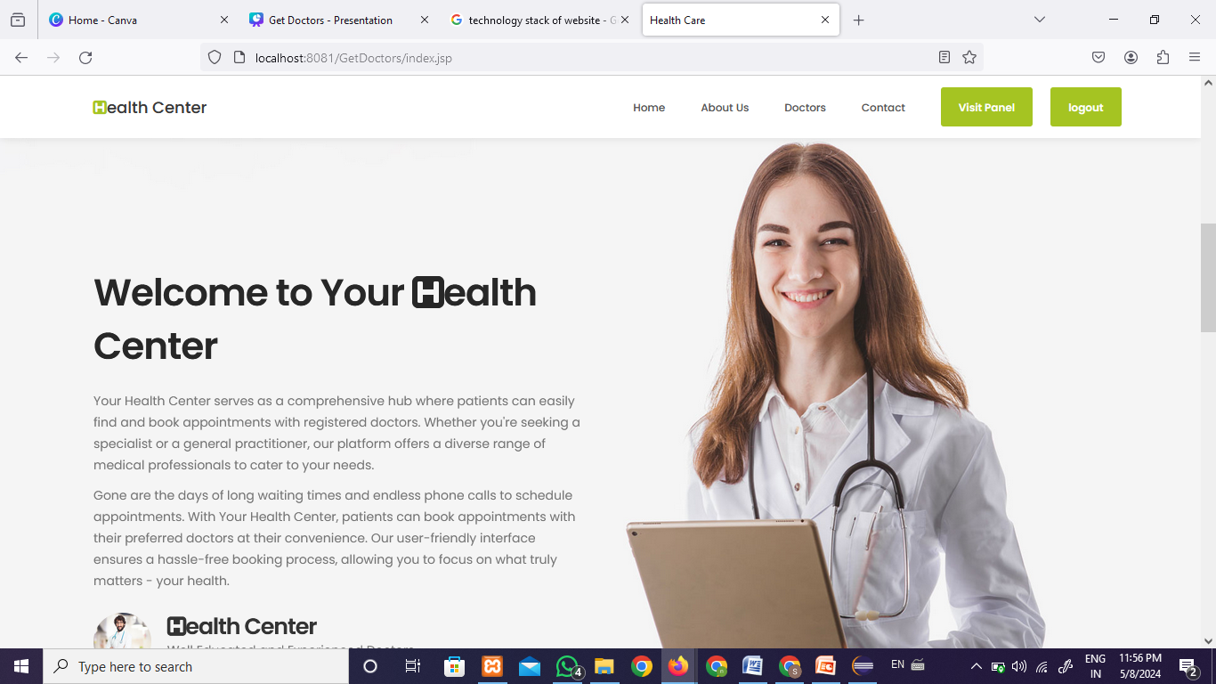
Get Doctors
Home Page 2 :-

Slide 26
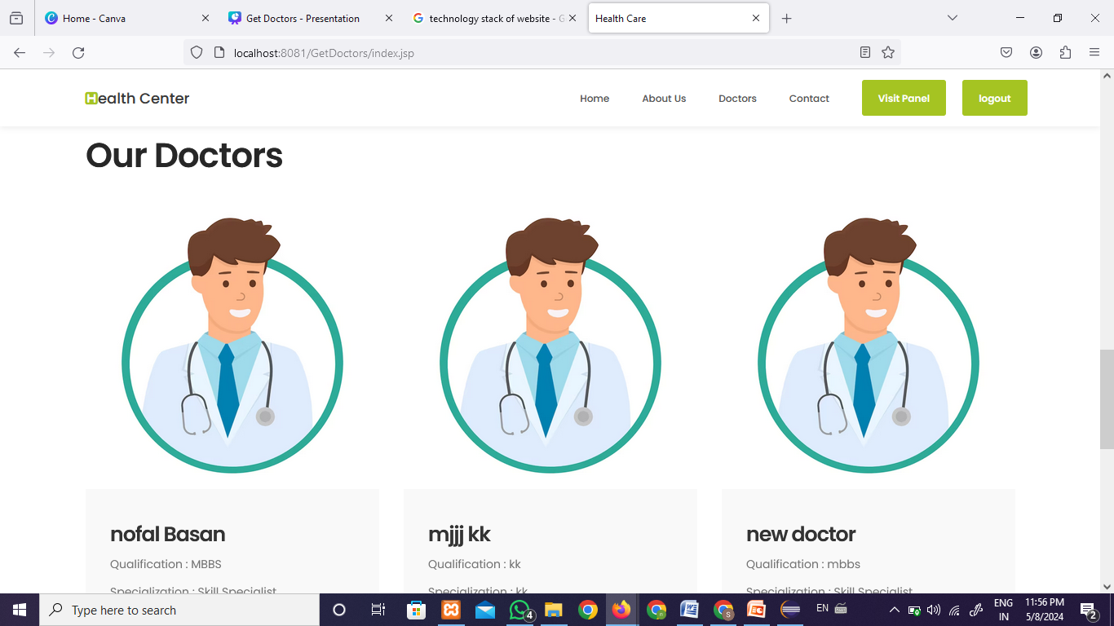
Get Doctors
Home Page 3 :-

Slide 27
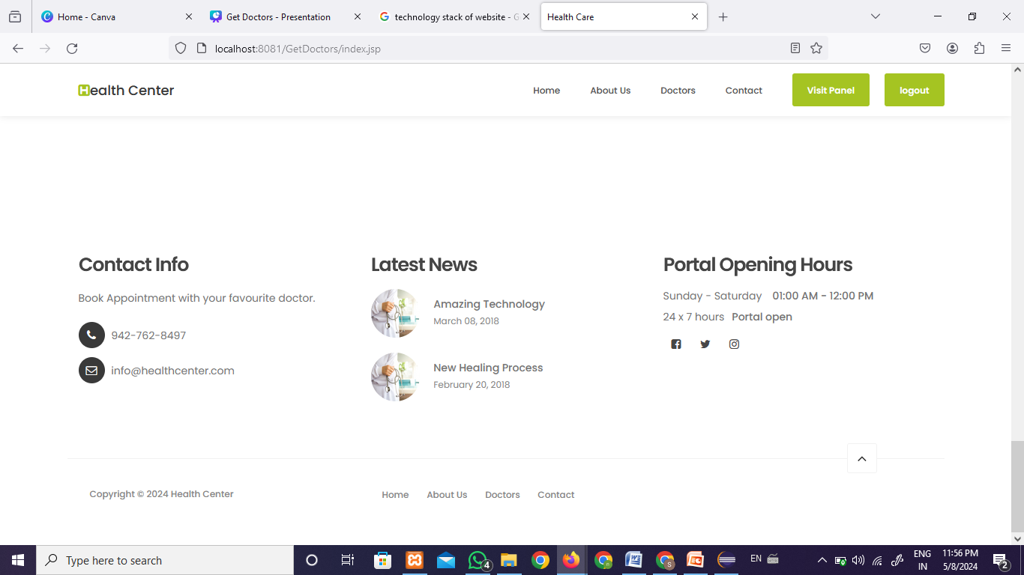
Get Doctors
Home Page 4 :-

Slide 28
Get Doctors
About us :-

Slide 29
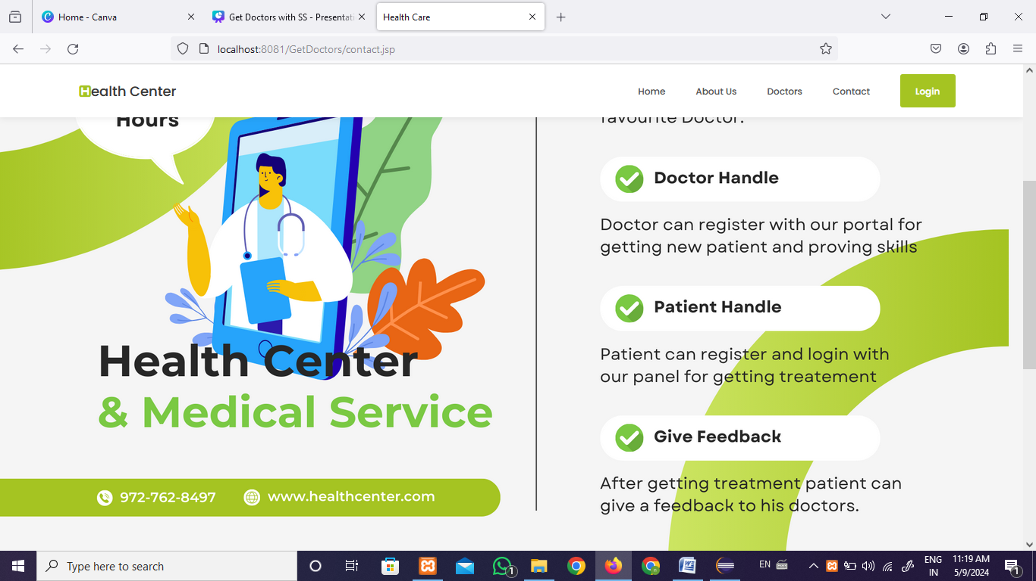
Get Doctors
Contact us :-

Slide 30
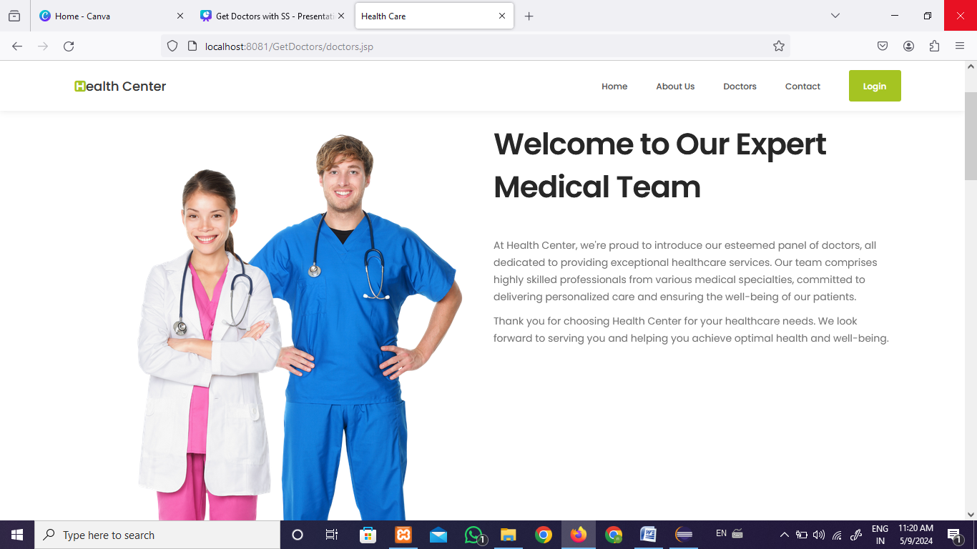
Get Doctors
Doctors 1:-

Slide 31
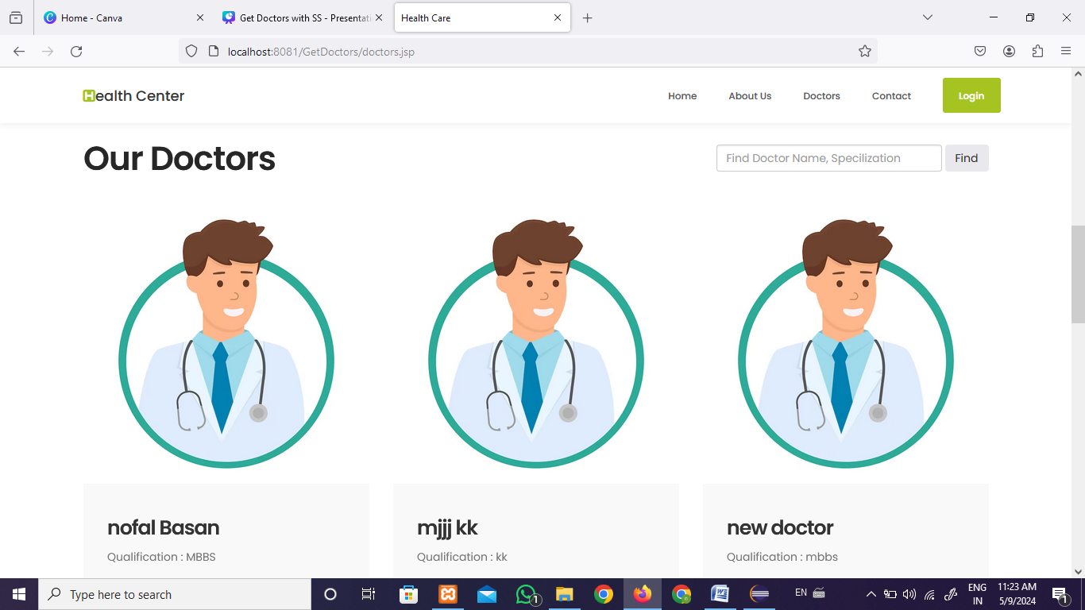
Get Doctors
Doctors 2:-

Slide 32
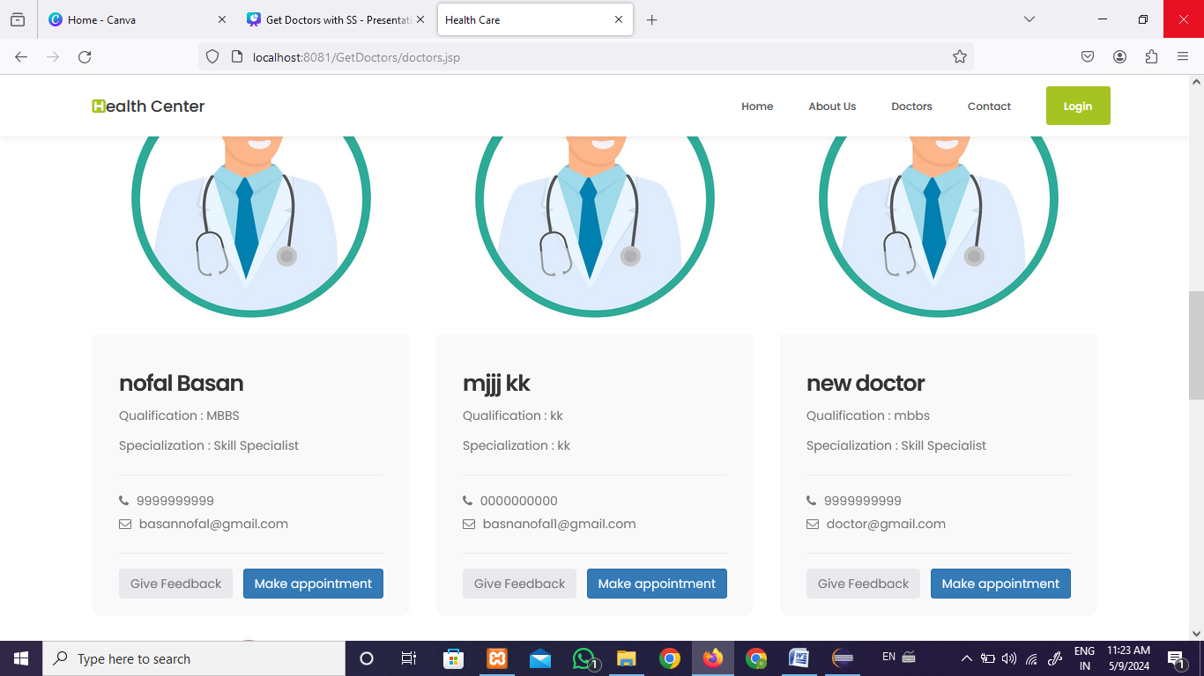
Get Doctors
Doctors 3:-

Slide 33
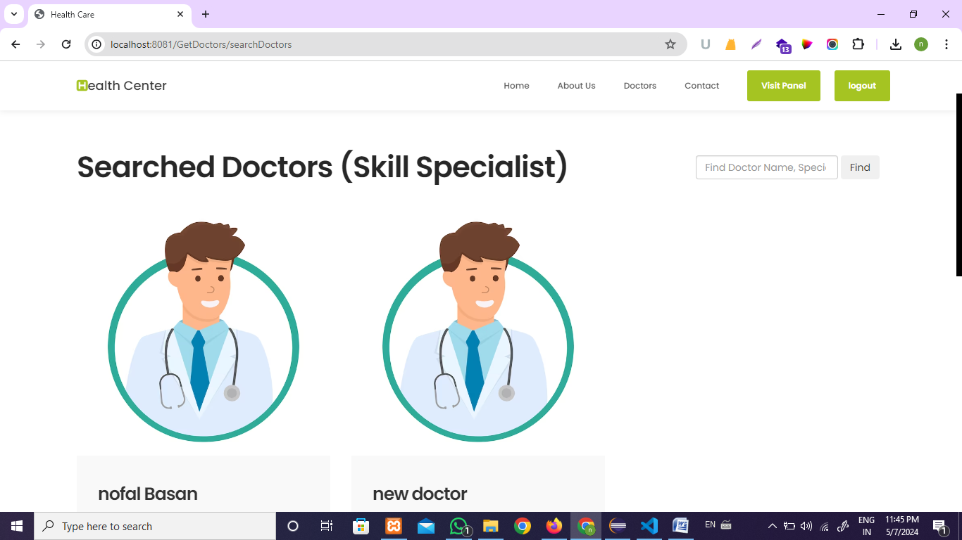
Get Doctors
Searched Doctors

Slide 34
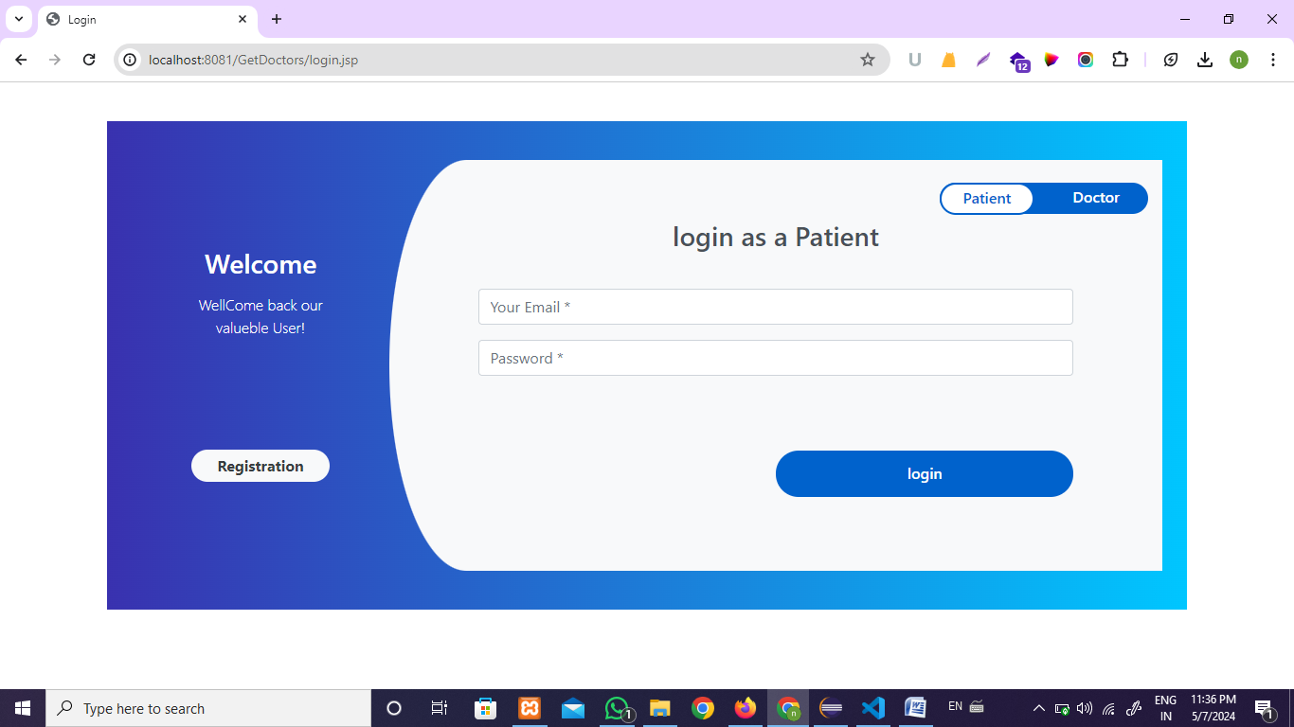
Get Doctors
patient and doctor login page:-

Slide 35
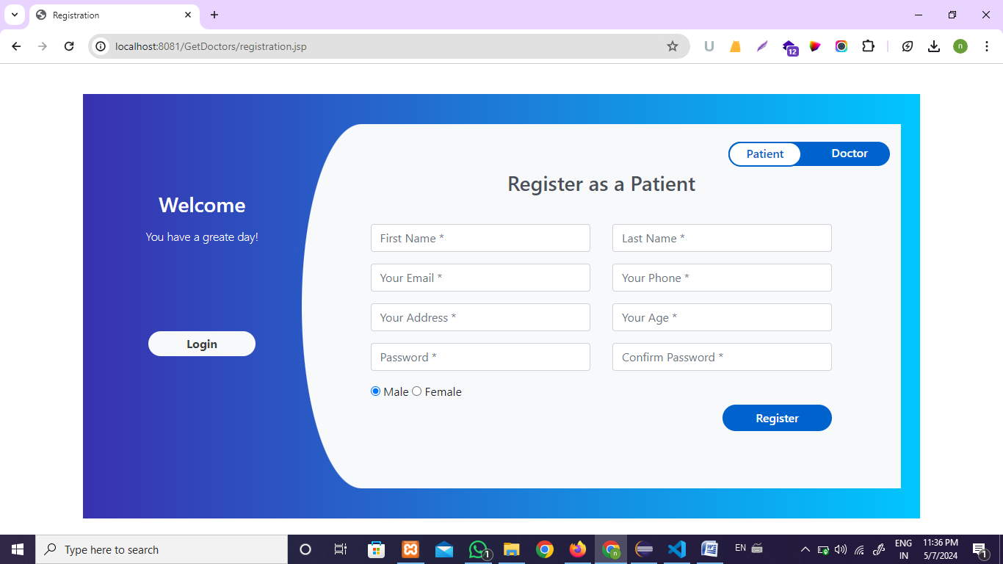
Get Doctors
patient and doctor Register page:-

Slide 36
Get Doctors
patient panel Screenshots

Slide 37
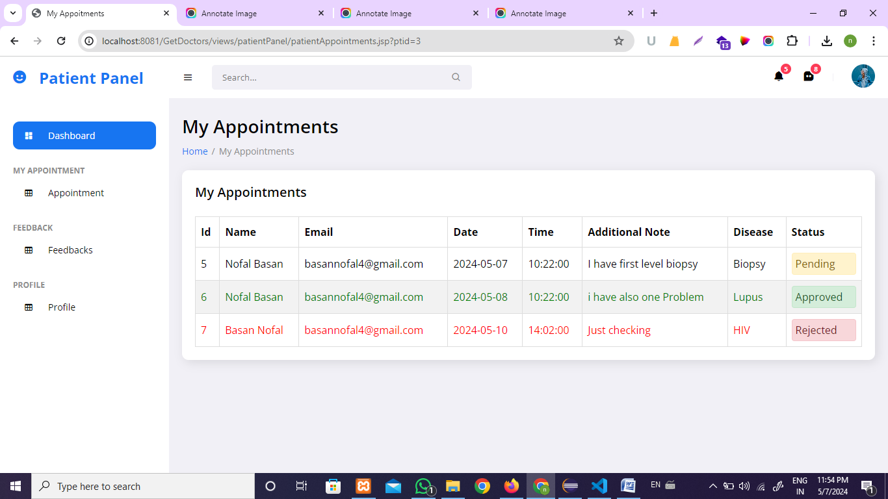
Get Doctors
Patient Appointments :-

Slide 38

Get Doctors
Patient Feedbacks :-

Slide 39
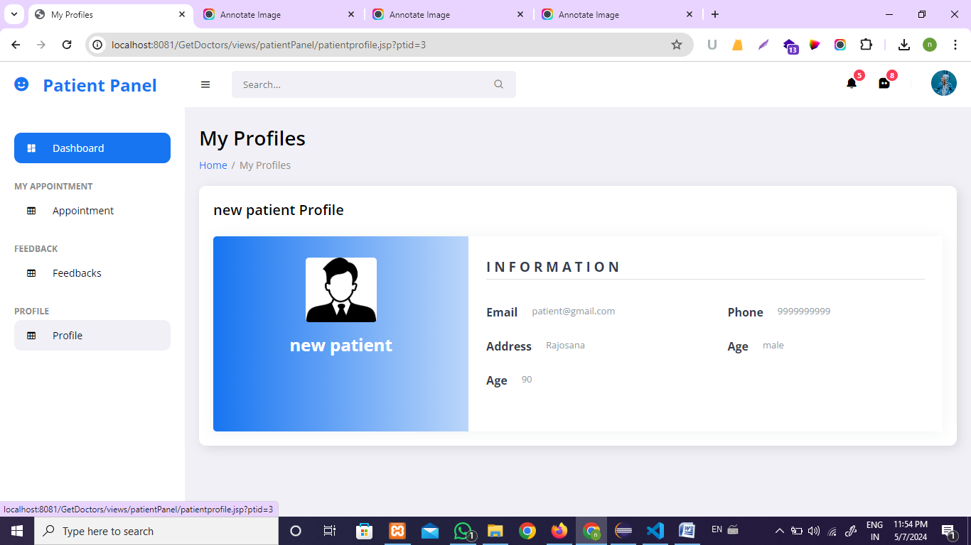
Get Doctors
Patient Profile:-

Slide 40
Get Doctors
Doctor panel Screenshots

Slide 41
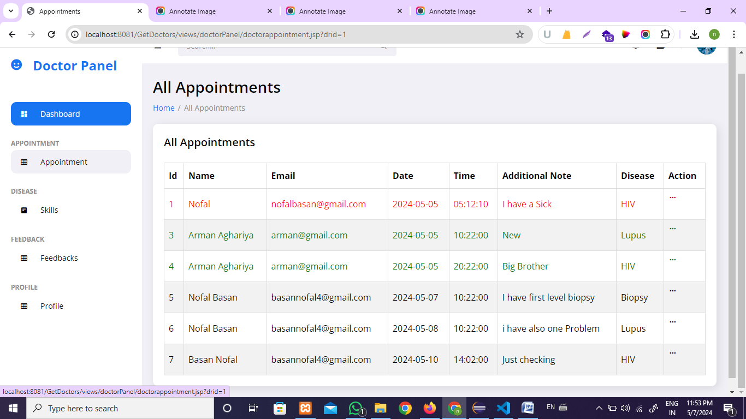
Get Doctors
Doctor Appointments :-

Slide 42

Get Doctors
Doctor Feedbacks :-

Slide 43
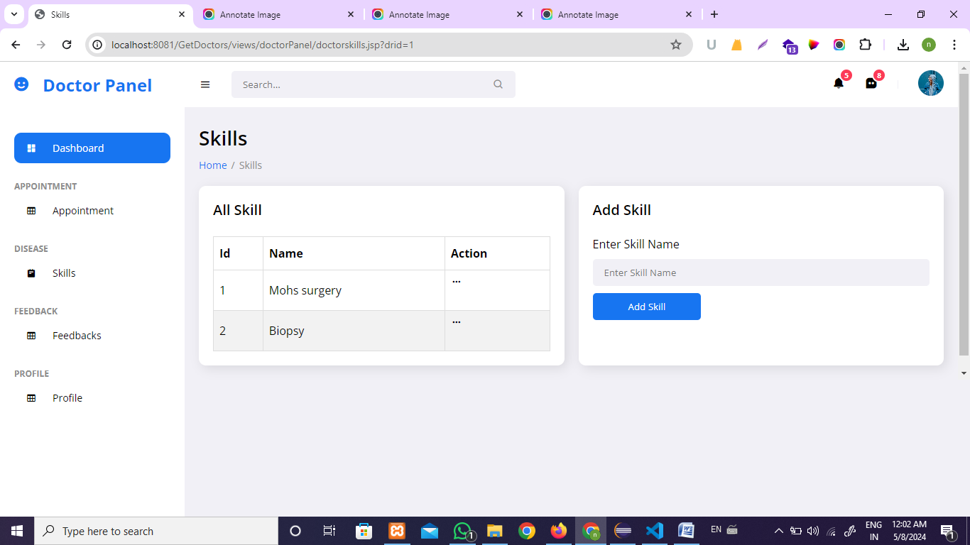
Get Doctors
Doctor Skills :-

Slide 44
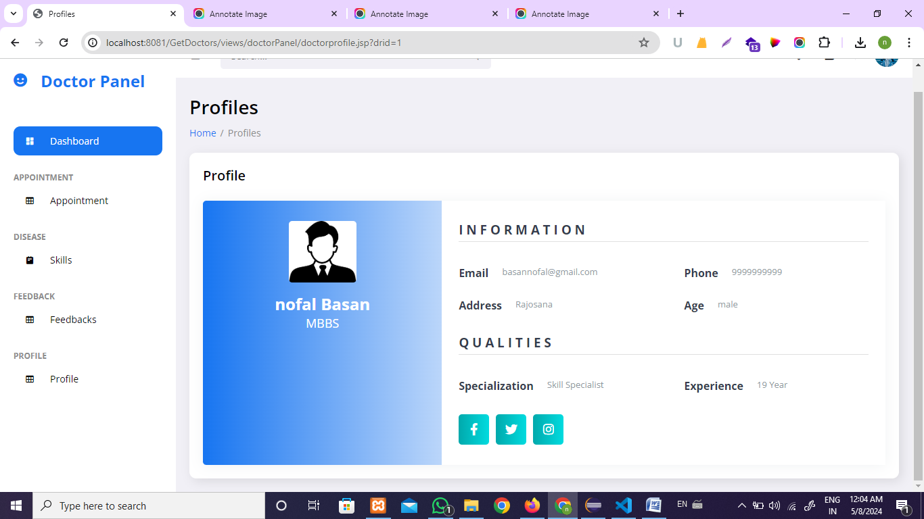
Get Doctors
Doctor profile :-

Slide 45
Get Doctors
Admin panel Screenshots

Slide 46
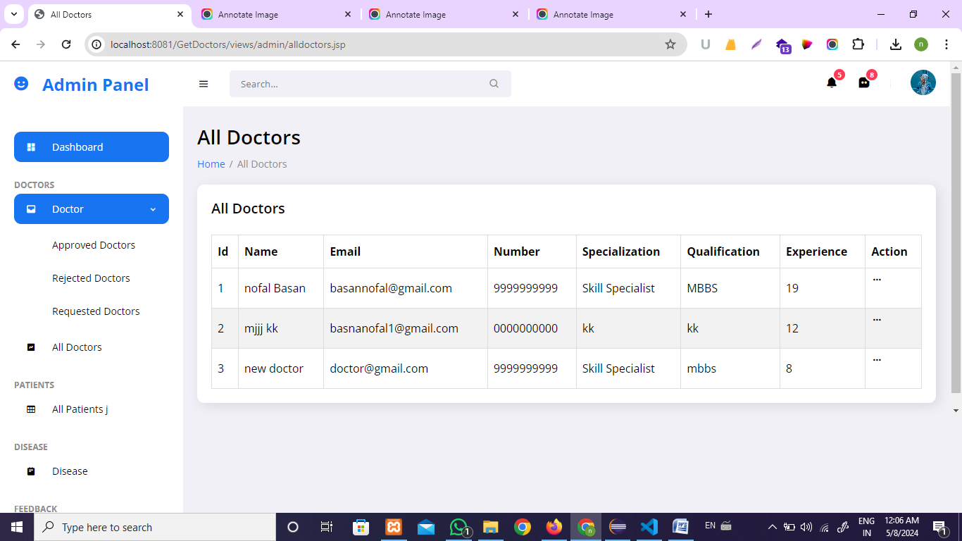
Get Doctors
Admin All Doctors :-

Slide 47

Get Doctors
Admin Approved Doctors :-

Slide 48
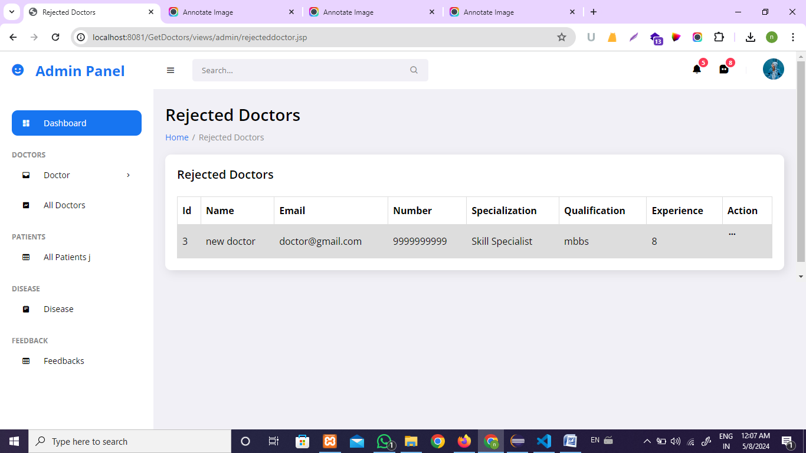
Get Doctors
Admin Rejected Doctors :-

Slide 49
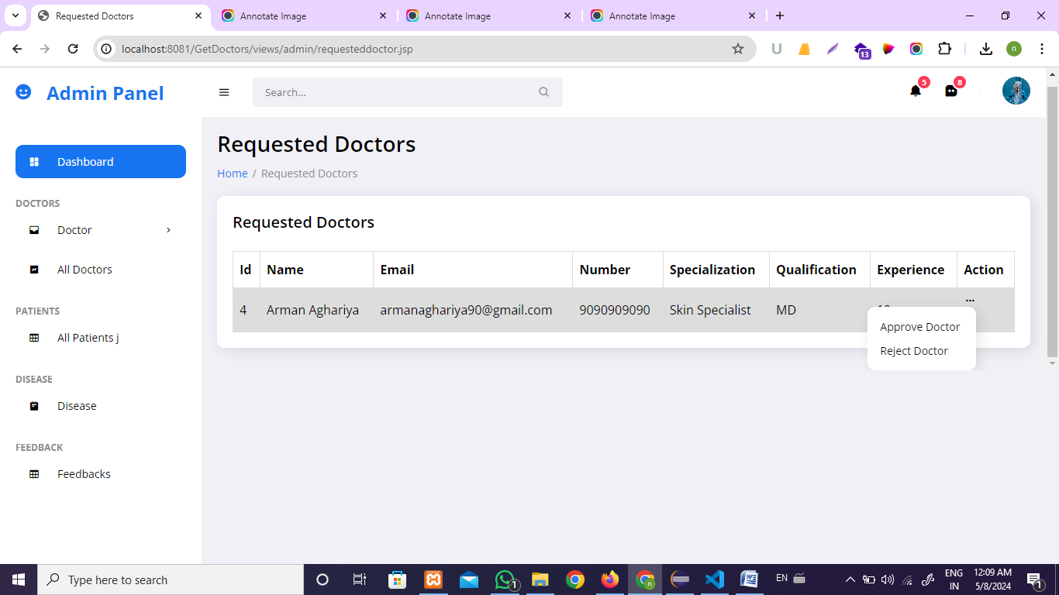
Get Doctors
Admin Requested Doctors :-

Slide 50

Get Doctors
Admin All Patients :-

Slide 51
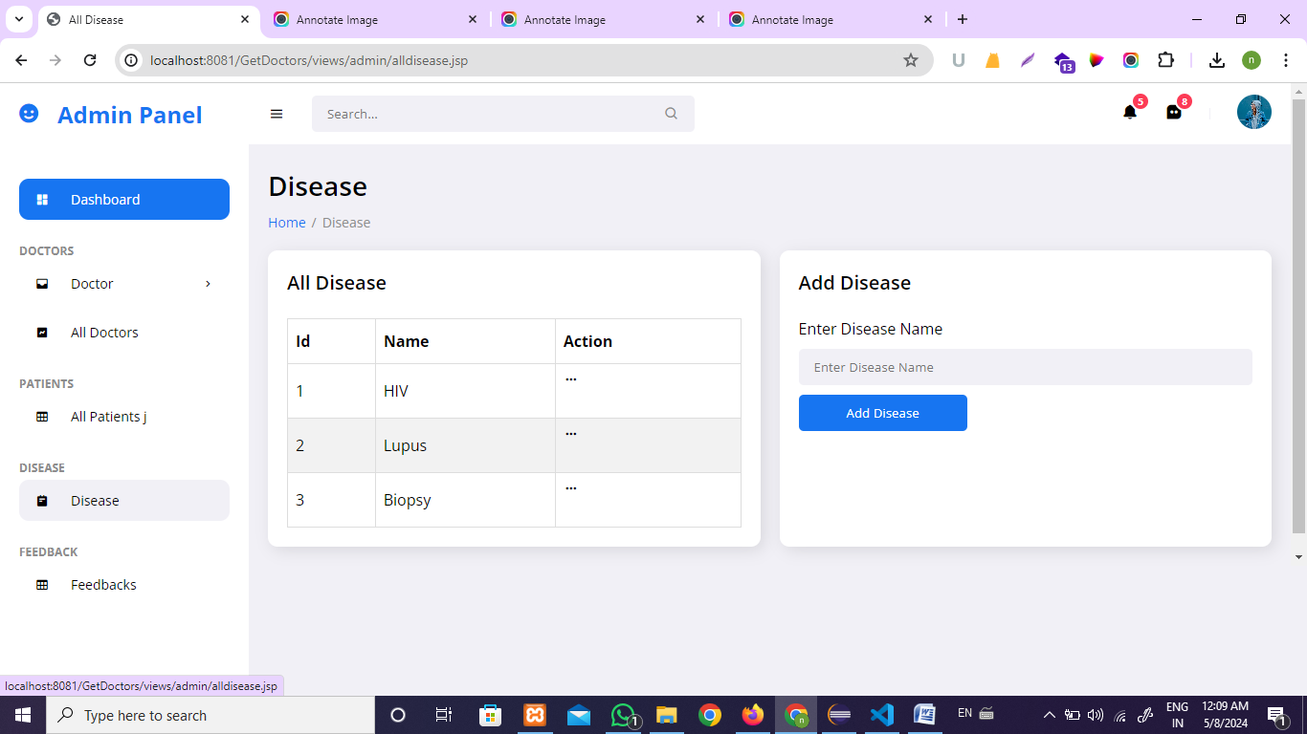
Get Doctors
Admin Manage Disease :-

Slide 52
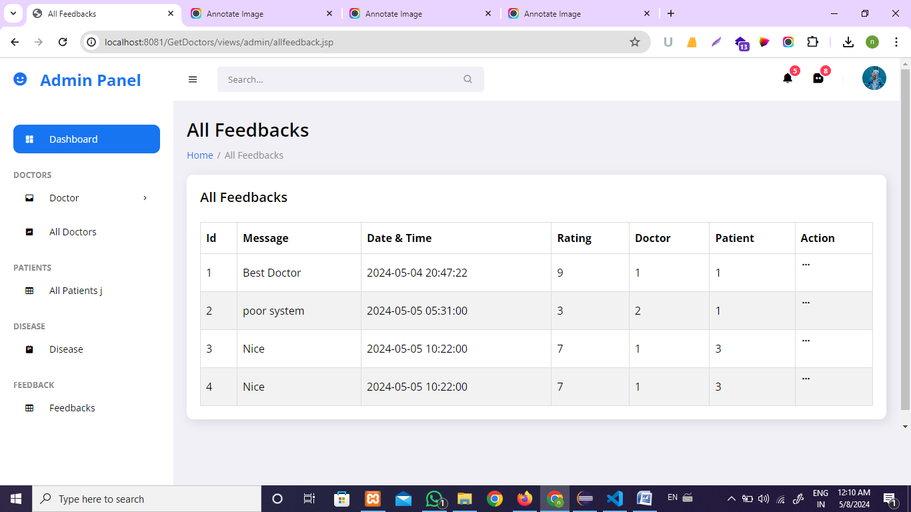
Get Doctors
Admin Manage Feedbacks :-

Slide 53
Get Doctors
Future Enhacement
Health Monitoring Tools : Introduce tools for patients to track their health metrics and share real-time data with their healthcare providers for proactive management of chronic conditions.
Language Translation Services : Integrate language translation capabilities to facilitate communication between patients and doctors from diverse linguistic backgrounds, improving accessibility and inclusivity.
Predictive Analytics for Patient Needs: Utilize predictive analytics to anticipate patient needs and recommend preventive measures or interventions, enhancing personalized healthcare delivery.
Interoperability with External Systems: Enable seamless integration with external healthcare systems, such as electronic health records (EHR) platforms, to facilitate the exchange of patient data and improve care coordination.
Community Health Initiatives: Implement community health initiatives within the platform to promote preventive care, health education, and wellness programs tailored to specific demographics or health needs.

Slide 54
Get Doctors
Conclusion
our project represents a significant step forward in revolutionizing the healthcare landscape by leveraging technology to enhance accessibility, streamline processes, and improve patient-provider interactions. Through features such as centralized appointment management, seamless communication channels, and transparent feedback mechanisms, we have successfully addressed key challenges in healthcare delivery.
By empowering both patients and healthcare providers with tools for efficient scheduling, communication, and record-keeping, our platform has contributed to a more patient-centered and collaborative approach to healthcare. Furthermore, the integration of future enhancements, such as telemedicine, AI-driven decision support, and remote monitoring, promises to further elevate the quality and effectiveness of care delivery.
As we continue to evolve and innovate, our commitment to advancing healthcare remains unwavering. We envision a future where access to high-quality healthcare is seamless, personalized, and inclusive for all. Together, we can shape a healthier tomorrow, where technology serves as a catalyst for positive change in the lives of individuals and communities worldwide.

Slide 55

Get Doctors
Tools
Used for developed
01
02
03
Chat GPT
PHPMyadmin
Canva
Documentation &
Other Purpose Reference
01
02
03
MySQL
Eclipse IDE
Stack Overflow

Slide 56


get doctors
THANK
YOU
Prepared By :-
Nofal Basan - 147
Arman Aghariya - 36
Sajjad Sunasara - 177

